Slide 1

Fabric Inspection
Group 6

Slide 2

CONTENT
COMPANY OVERVIEW
PROBLEM
SHRINKAGE
SHRINKAGE PROCESS
MAJOR ISSUES
TI

Slide 3
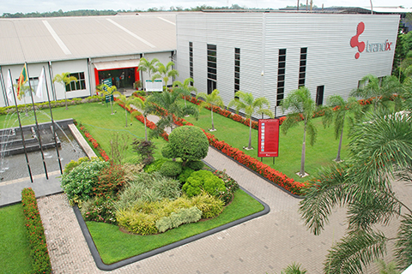
BRANDIX
Inspired Solutions
Leading apparel solutions provider in Sri Lanka
Manufacturing presence in India and Bangladesh
Providing Inspired Solutions to renowned brands across the world for nearly 50 years
There are 60,000+ number of employees currently working

Slide 4
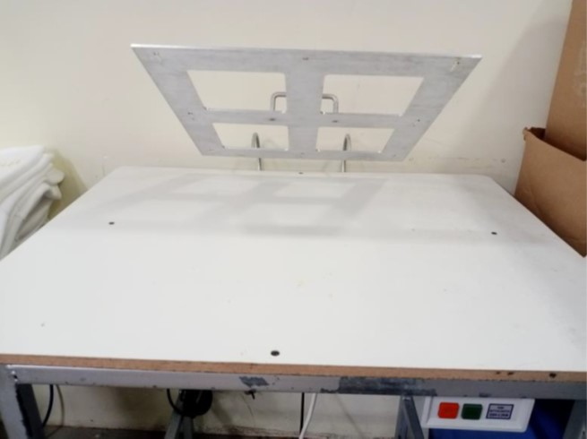
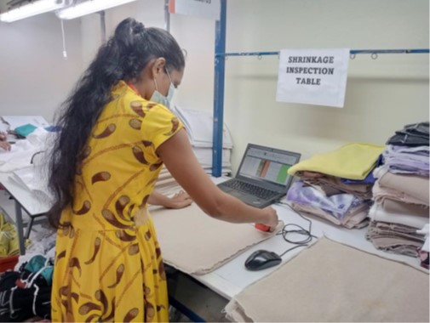
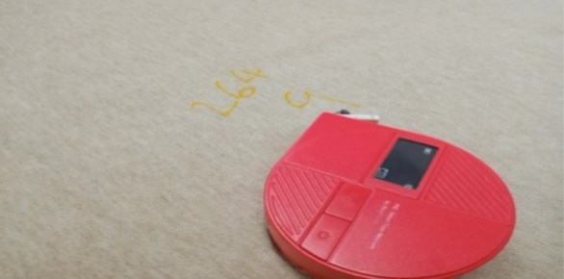
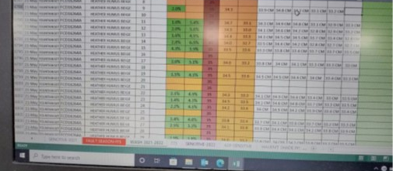
PROBLEM -
Measuring the shrinkage.
OUR FOCUS
Identify the problem
Suggest Solutions

Slide 5
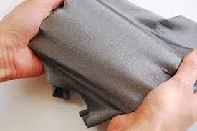
Shrinkage
Shrinkage of cloth refers to the reduction in size of a piece of fabric after washing, dying of fabric procedure and when exposed to the relaxing of fabric.

Slide 6
As we wash garments we do the residual shrinkage first.
Residual shrinkage means we unroll the fabric as layers we keep it for 24 hours to relax to avoid the tension that is within the fabric roll.

Slide 7
If residual shrinkage is 2% they accept the garment and if not, they talk with supply and request for another lot.
In residual shrinkage process all the rolls are relaxed. (100% done for all fabric).

Slide 8
Shrinkage Process (pillow Case process)
STEP 01
STEP 02
STEP 03
STEP 04
Take 1 yard of cloth of piece from each roll. (This piece of cloth include batch number as well as roll number).
Take that piece of fabric and marked 8 points using textile pen using standard shrinkage board. Those measurements are taken from Bluetooth tape that is machine which will update the measurements in the excel automatically.
Then send it to the wash and dye.
Keep that cloth to dry and once received fabric check whether distance between point that measured before using Bluetooth tape by man.
Then they measure the variation.(0.5 cm differ it 1.5% effect, 1 cm differ it 3% effect like wise).
That variation is sent to the technical team and according that variation they design how the rolls are used.

Slide 9

Major Issues
Issue in measuring the shrinkage
Because measurements with the Bluetooth tape depend on people doing it manually
There's a chance of getting wrong results if the tape isn't put in the same place each time. This is a hands-on process, and if the tape isn't consistently placed, the measurements might not be right.

